Slide 1
PRICING TEST PRESENTATION

Slide 2
Project Team
Ahmed Samad
Nadir Syed
Muhammad Ikram Qadri
Project Lead
Project Manager
Lead ML Engineer
Operations
Data Analyst
14+ financial industry experience and hands on machine learning in python, R, Rapid Miner, BigML and SAS Enterprise miner
Data analyst experience in various business domains including Finance, Logistics & SAP etc.
Working in Aviation & Power industry for 18 years. Experienced in Project Mgmt., Process Improvement and Systems Engineering

Slide 3
Price Testing
Concept
One of the biggest challenges for most companies launching a new product or services are PRICING.
Price Testing is a very simple concept but one of the most difficult project to undertake that can be implemented in multiple different ways from least complex to the most.
Goal
We have been hired as a Data Scientist to evaluate the pricing of the product to maximize the earnings in result increase in revenue by identifying & calculating the most relevant KPI’s and in depth analysis.
Strategy Example
Lower price might lead to more sales vs. a higher price. But a higher price means more revenue per sale. So it is all about finding the RIGHT MIX.

Slide 4
Business Challenges/Questions
Objectives:
Which state has the most sales?
What is the best marketing channel to attract more customer?
Which price point the company should use in future?
What days in the week would be best to send promotion?
Were test customers really purchasing tickets?

Slide 5
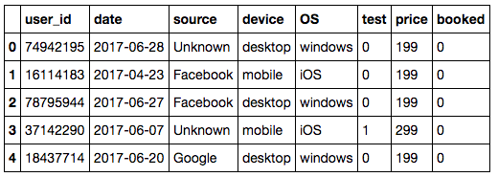
Data Understanding
Examine-Enumerate-Visualize
First table: Promo_results.csv
Data dictionary:
user_id - Unique ID of visitor.
date - Date the visitor received the promotion.
source - Marketing channel that the visitor came from.
device - Mobile or desktop.
OS - Visitor device's operating system.
test - Did the visitor belong in the test group?
price - The price seen for the rafting trip.
booked - Did the visitor book a trip?

Slide 6
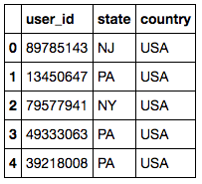
Data Understanding
Examine-Enumerate-Visualize
Second table: user_data.csv
Data dictionary:
user_id - Unique ID of visitor.
state - State of origin.
country - Country of origin

Slide 7
Data Understanding
Examine-Enumerate-Visualize
Promo_results: attributes
• user_id – Nominal (discrete attribute)
• date – Interval data
• source – Ordinal
• device - Ordinal • OS - Ordinal
• test – binary data
• price – two prices $199, $299
• booked – binary data
What is Target variable?
Booked to be considered as target variable
User_data: attributes
• user_id – Nominal (discrete attribute)
• state – Ordinal
• country - Ordinal

Slide 8

Data Understanding
Examine-Enumerate-Visualize
Characteristics | Promo results | User data
Columns | User_id, date, source, device, OS, test, price, booked | User_id, state, country
Number of rows | 268,878 | 233,961
Missing data / mismatch data | Date (8,687 or 3% of total data) | 34,918 state col missing, 15%
Column: booked (target variable) | Ones (4,929 or 2%) zeros (263,949 or 98%) | N/A
Column: user_id | No duplicate | No duplicate
Column: date | March 29- July 01(everyday record)
Column: price | $299 (96,938 or 36%) $199(171,940 or 64%)
Column: test | Ones (96,904 or 36%) zeros (171,974 or 64%)

Slide 9
Data Transformation

Slide 10
Transformation
Price | Number assignment
199 | 0
299 | 1
Booked | Number assignment
Not booked | 0
Booked | 1
Device | Number assignment
Mobile | 0
Desktop | 1

Slide 11
Transformation
OS | n-1
android | os_android
iOS | os_ios
linux | os_linux
mac | os_mac
Windows | os_windows
Other | This item is deleted/set to ) from data

Slide 12
Transformation
Source | n-1
Adwords | source_adwords
Bing | source_bing
Facebook | source_facebook
Google | source_google
Other | source_other
Unknown | This item is deleted from data

Slide 13
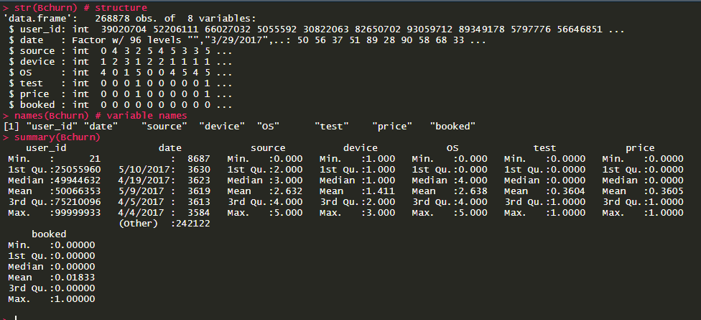

Slide 14
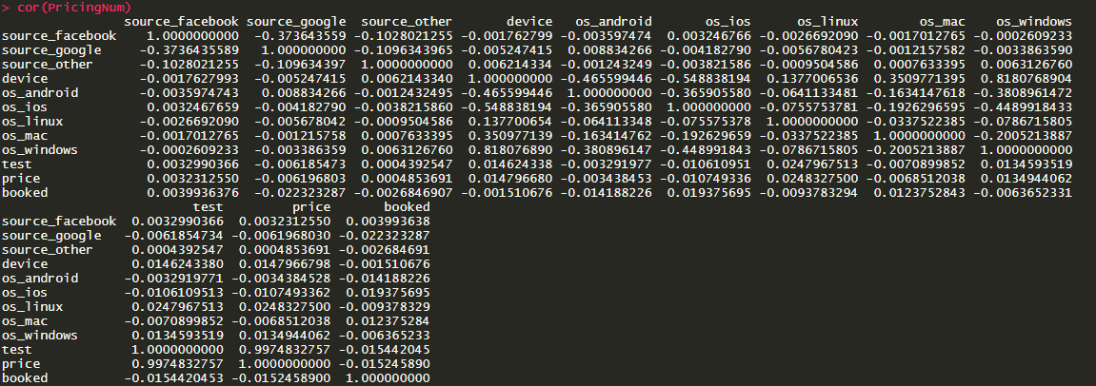

Slide 15
Structure of Data
Source – (android, iOS, linux, mac, other, windows) Categorical
Device – (Mobile, Desktop)
Test – (0,1)
Price – (199,299)
Booked- (0,1)
ANALYSIS
Classification

Slide 16
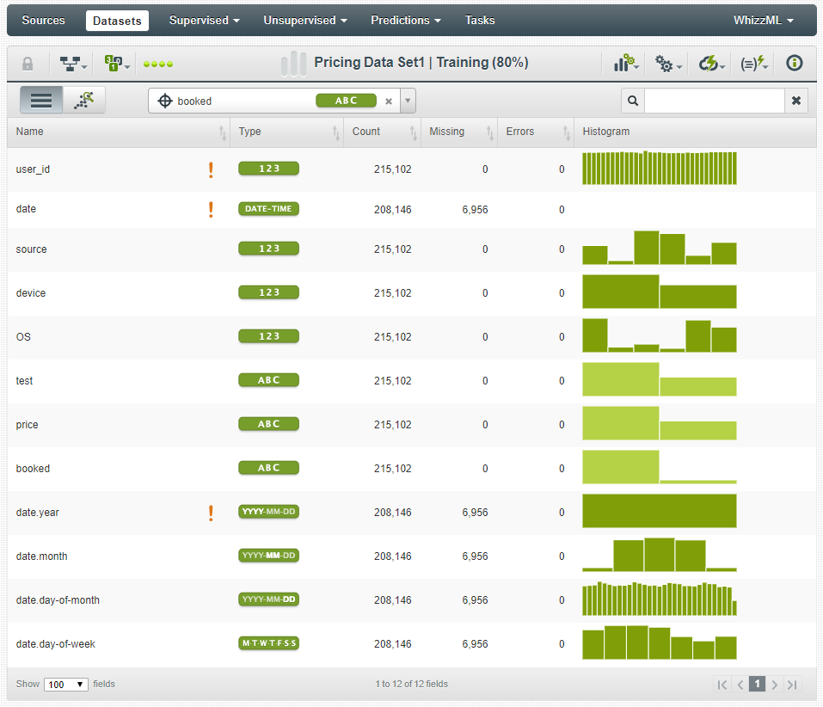
Data set detail on BigML

Slide 17
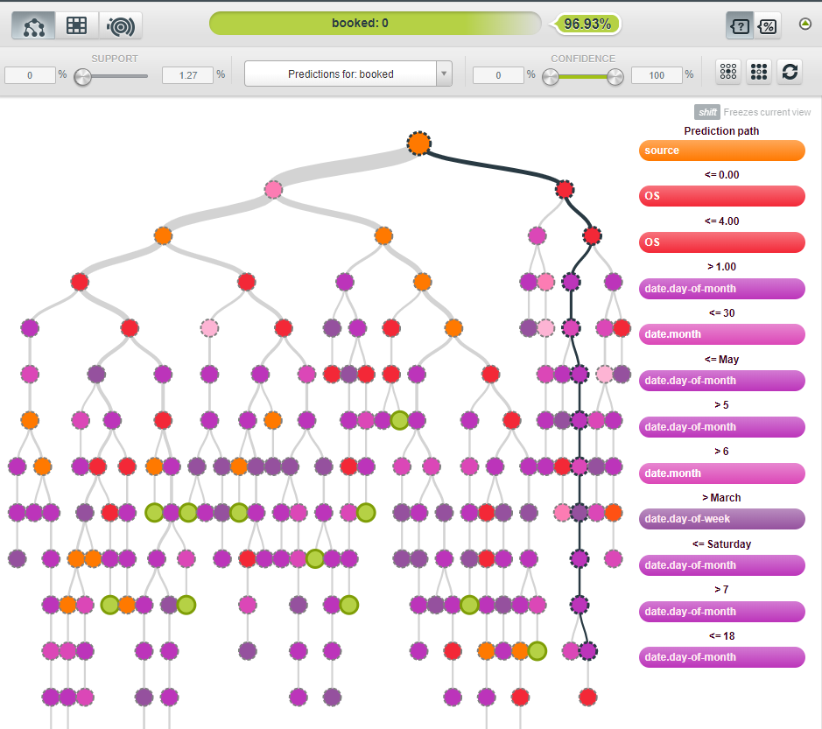
Classification Tree using BigML

Slide 18
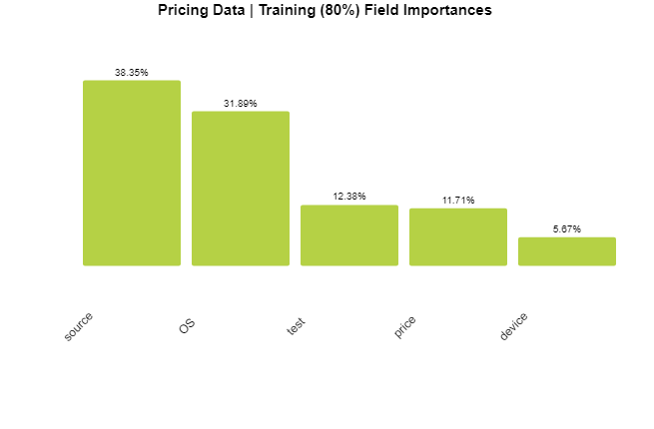
BigML Classification results without time stamp

Slide 19
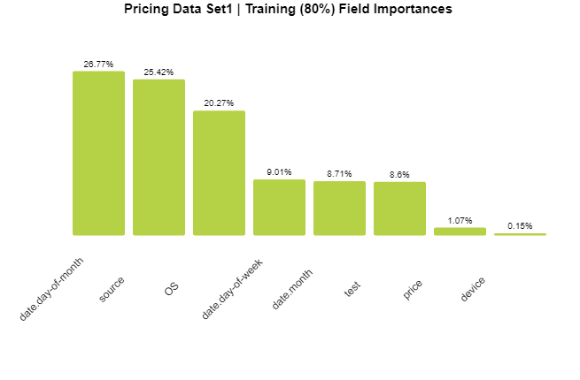
BigML Classification results with time series

Slide 20
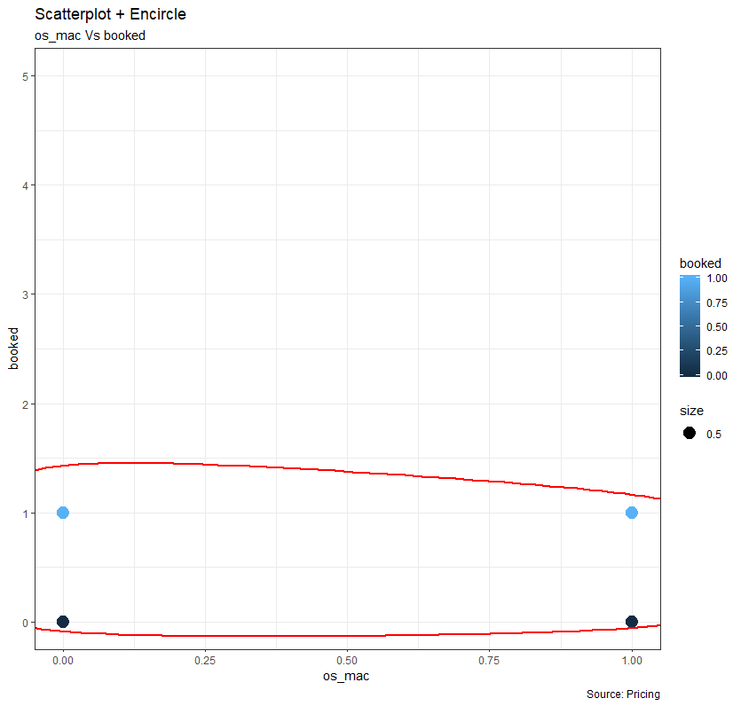
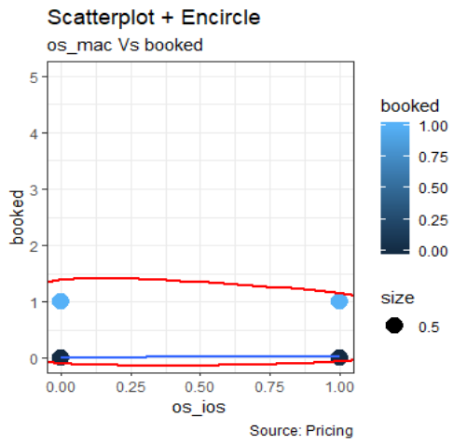

Slide 21
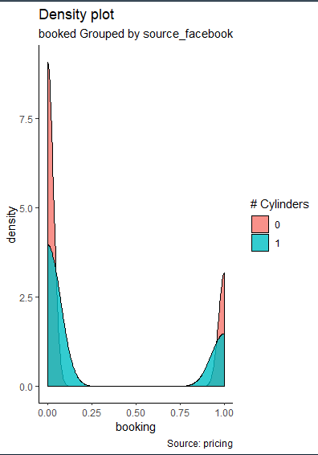
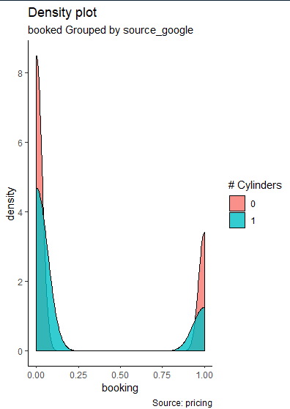
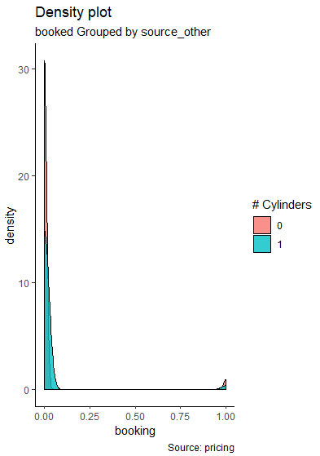

Slide 22
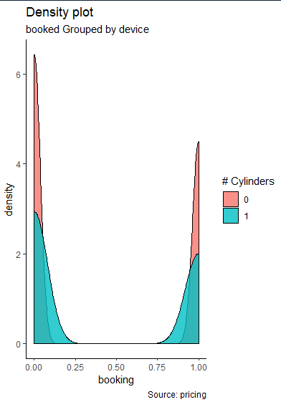
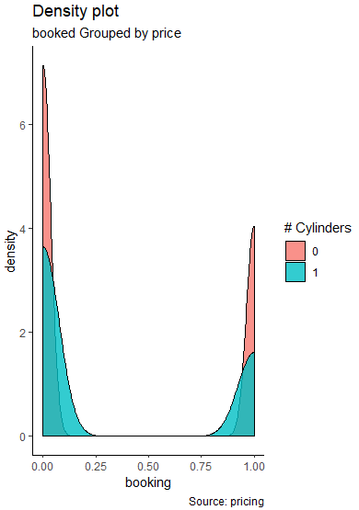

Slide 23
Business Challenges/Questions
Objectives:
Which state has the most sales?
What is the best marketing channel to attract more customer?
Which price point the company should use in future?
What days in the week would be best to send promotion?
Were test customers really purchasing tickets?

Slide 24
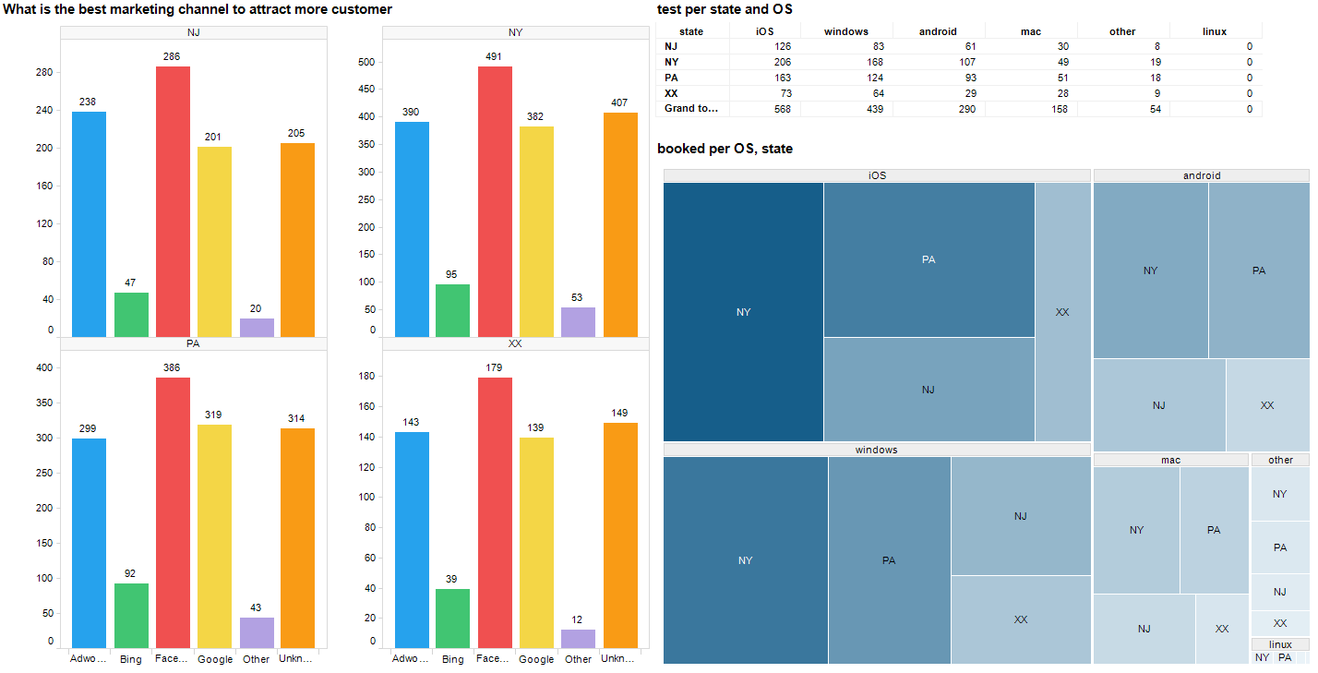
SATE WITH MOST SALES
State with most sales
Filter Settings
- booked: (1)

Slide 25
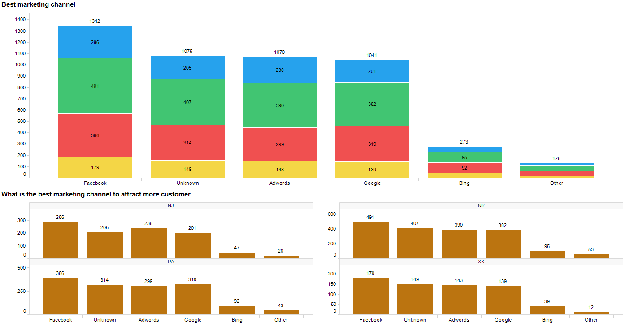
Marketing Channels
Filter Settings
- booked: (1)

Slide 26
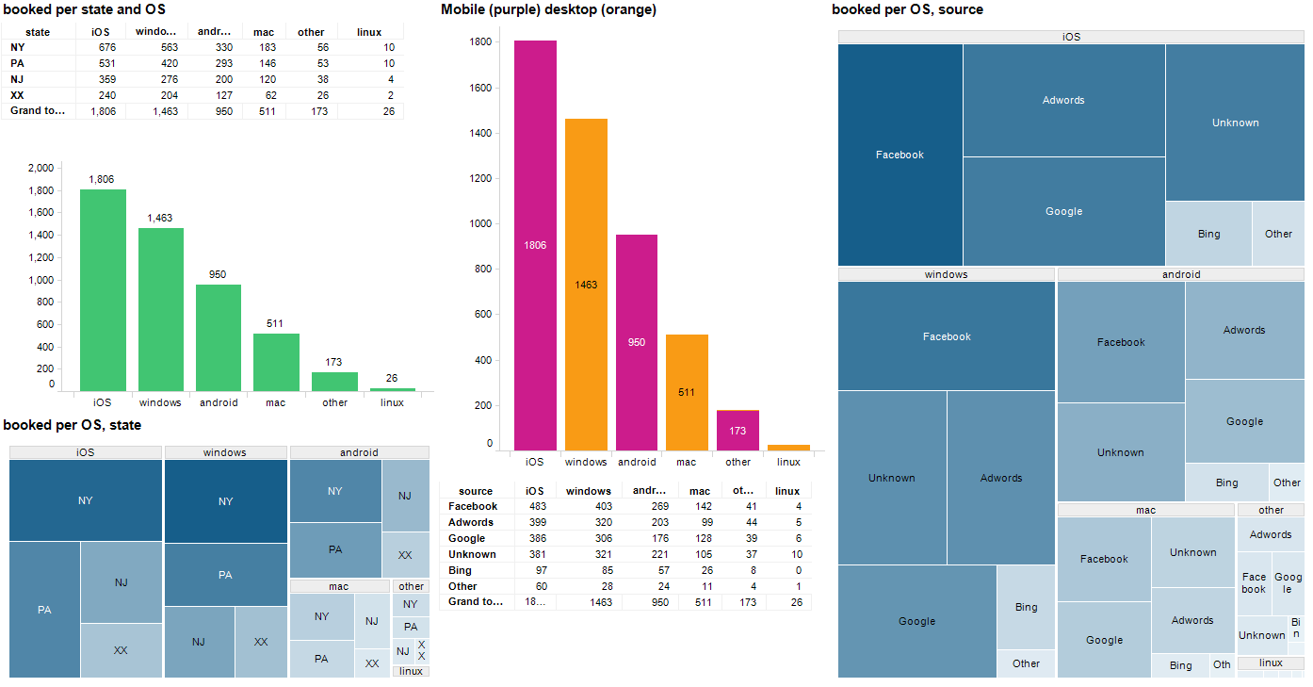
Popular Operating System

Slide 27
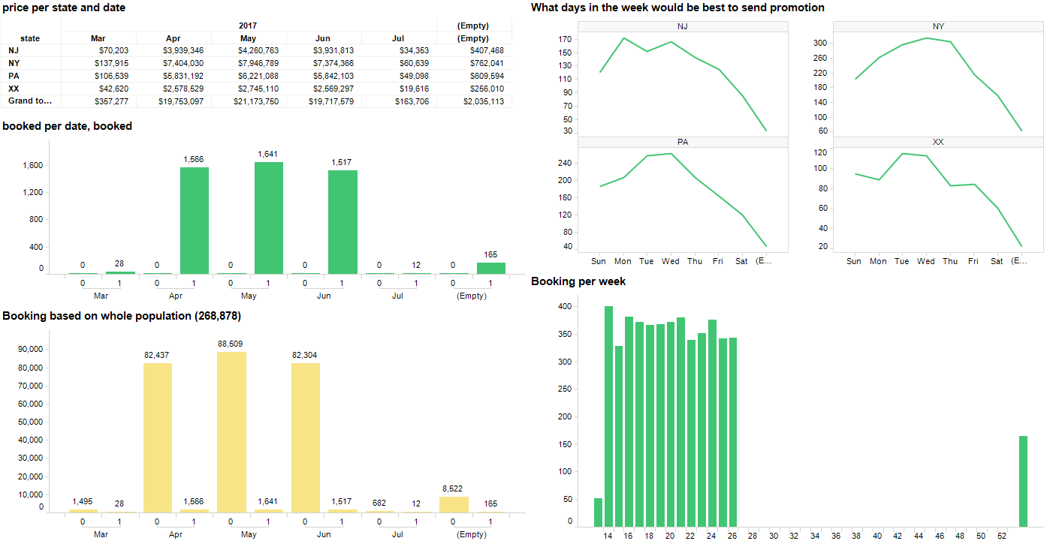
Best time to promote

Slide 28
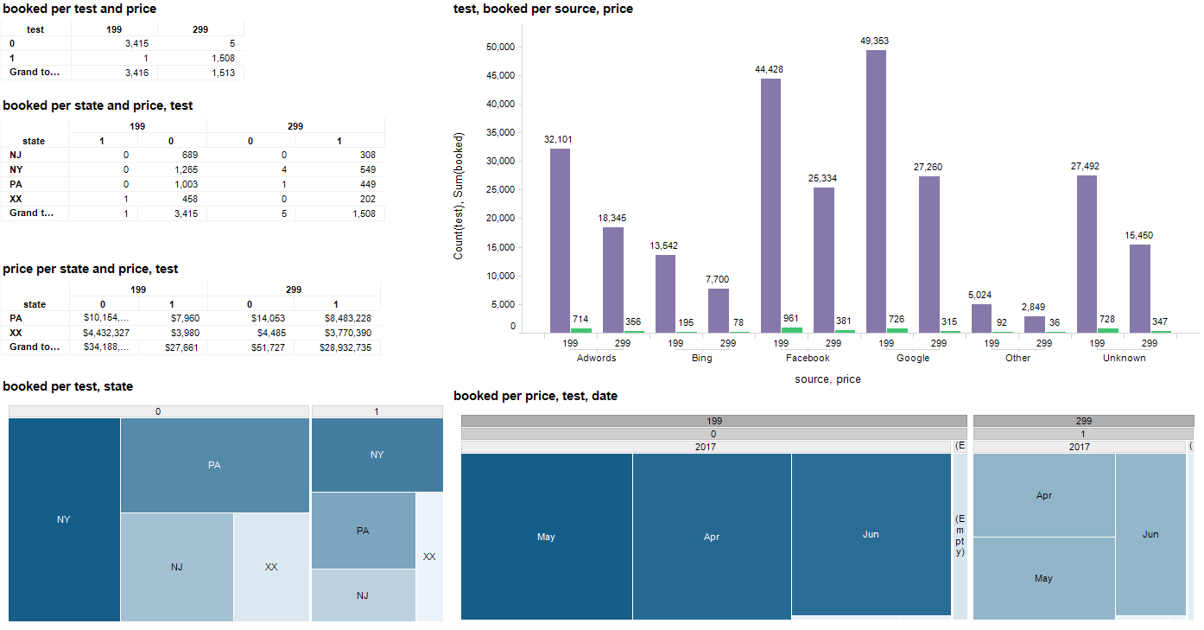
Test customer purchasing power

Slide 29
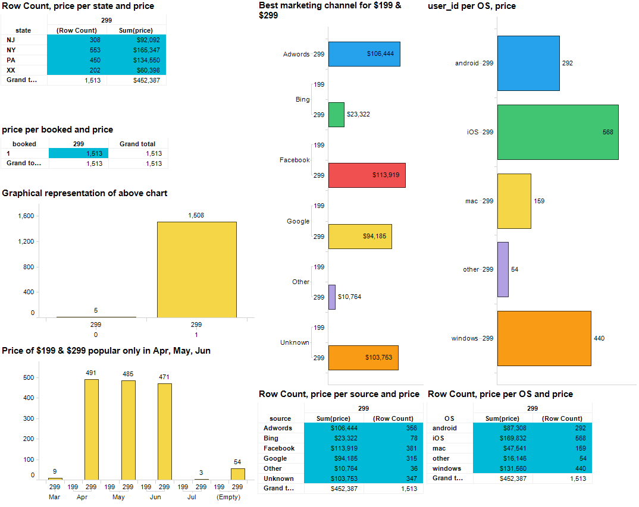
Future price point
Filter Settings
- price: (299)
- booked: (1)

Slide 30
Findings:
Wednesdays were best to sent out promotions
New York has the most sales
Facebook is the best channel
Mobile looks more popular than desktop
Apple iOS was more used than windows and android
99% of test customer select $299
$299 price could yield better profit margin
More data is needed to classify source “Unknown”
Only 2% of population booked the ticket
Management action items:
15% state data missing, find it to ensure which state has best sales
Source “Unknown” (channel) to be investigated to ensure which channel company needs to invested more
More investment or tests for new sources like Instagram, twitter etc. to have better understanding on pricing

Slide 31
THANK YOU

